Slide 1
User roles definitions
What will they do?
User： people who need education resource
Student
Teacher
Finding educational resources, asking questions, answering questions, bookmarking or downloading what they want to see.
Provider：
Teacher who has education resource
Volunteer
Uploading educational resources, answering questions, deleting(managing) what they have uploaded.
Administrator:
Web administrator
Educational institutions and
non-governmental organizations
Managing the education resources, managing the user, managing the modules and managing the reviews
I interviewed some people involved and contacted Children in impoverished areas to do a user survey by calling.
I used to volunteer to teach in a poor primary school, so I have the contact information.

Slide 2

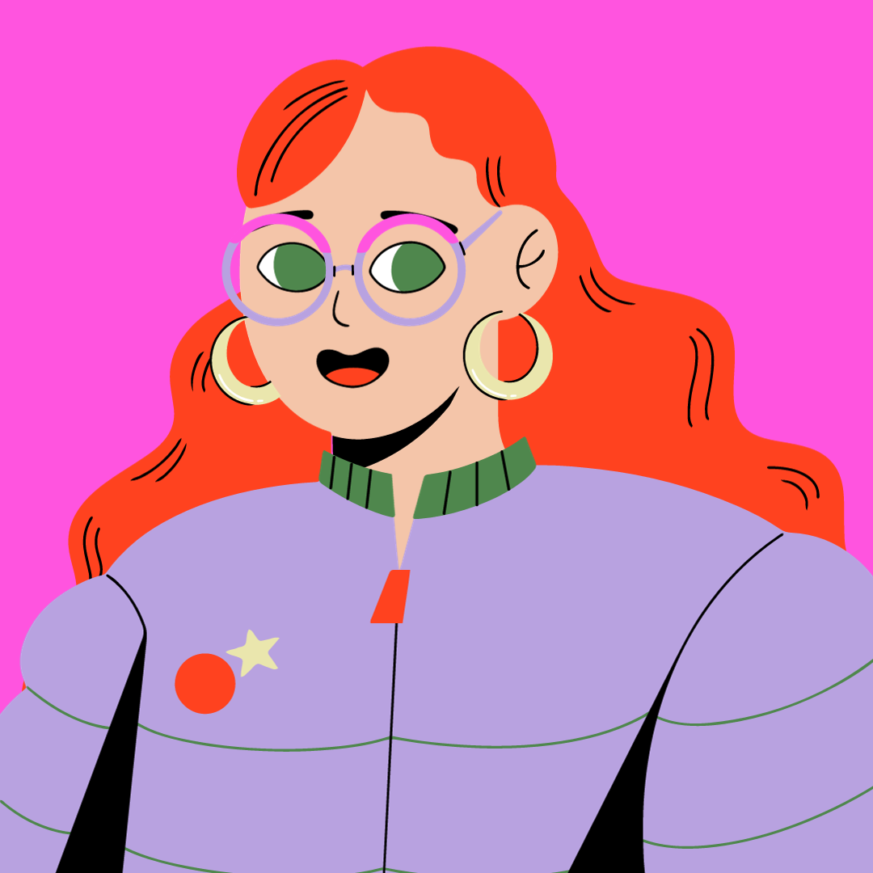
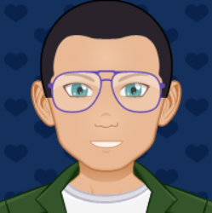
Potential User Persona Profiles
Application | Website for education
Profile Pic
Name | Hua Li | Noria | Hanson | David
Age | 13 | 32 | 23 | 46
Occupation | Student | Teacher | volunteer | Admin
Tech with which User is familiar | android phone, windows | android phone, windows | IPhone, iPad, android phone, mac, windows, tablet, apple watch | Android phone, laptop, tablet, mac, windows
Persona Characteristics - Why would this user access the proposed application? | They want to find educational resources, read books and ask questions about what they are confused about. | They would use the application to find educational resources to teach the students. Hope can help themselves to improve their teaching. | They‘re the volunteer of the application - to upload the educational resources to the website. Help people to solve some problems they are confused about. | They are the administrator for the application, including Educational institutions, non-governmental organisations and web administrators. They will manage the user, educational resources and reviews.
Accessibility considerations | Language - they will speak a different language Lack of proficiency in the use of electronic devices Disability | Language - they will speak a different language. | None | Colour deficiency
Requirements by user for the application | Vision disability - Options to change font size/WAI-ARIA Easy to navigate User friendly Quick to navigate through for customer | Quick to navigate through for the customer Easy to navigate User friendly | Easy to operate Strong compatibility - Strong compatibility | Manager the module provides Manager the uploaded contents Manager user reviews
Casual/Power User | Casual | Casual | Casual | Power
Notes:
Virtual Image: https://www.canva.com/create/avatars/
https://avatarmaker.net/

Slide 3
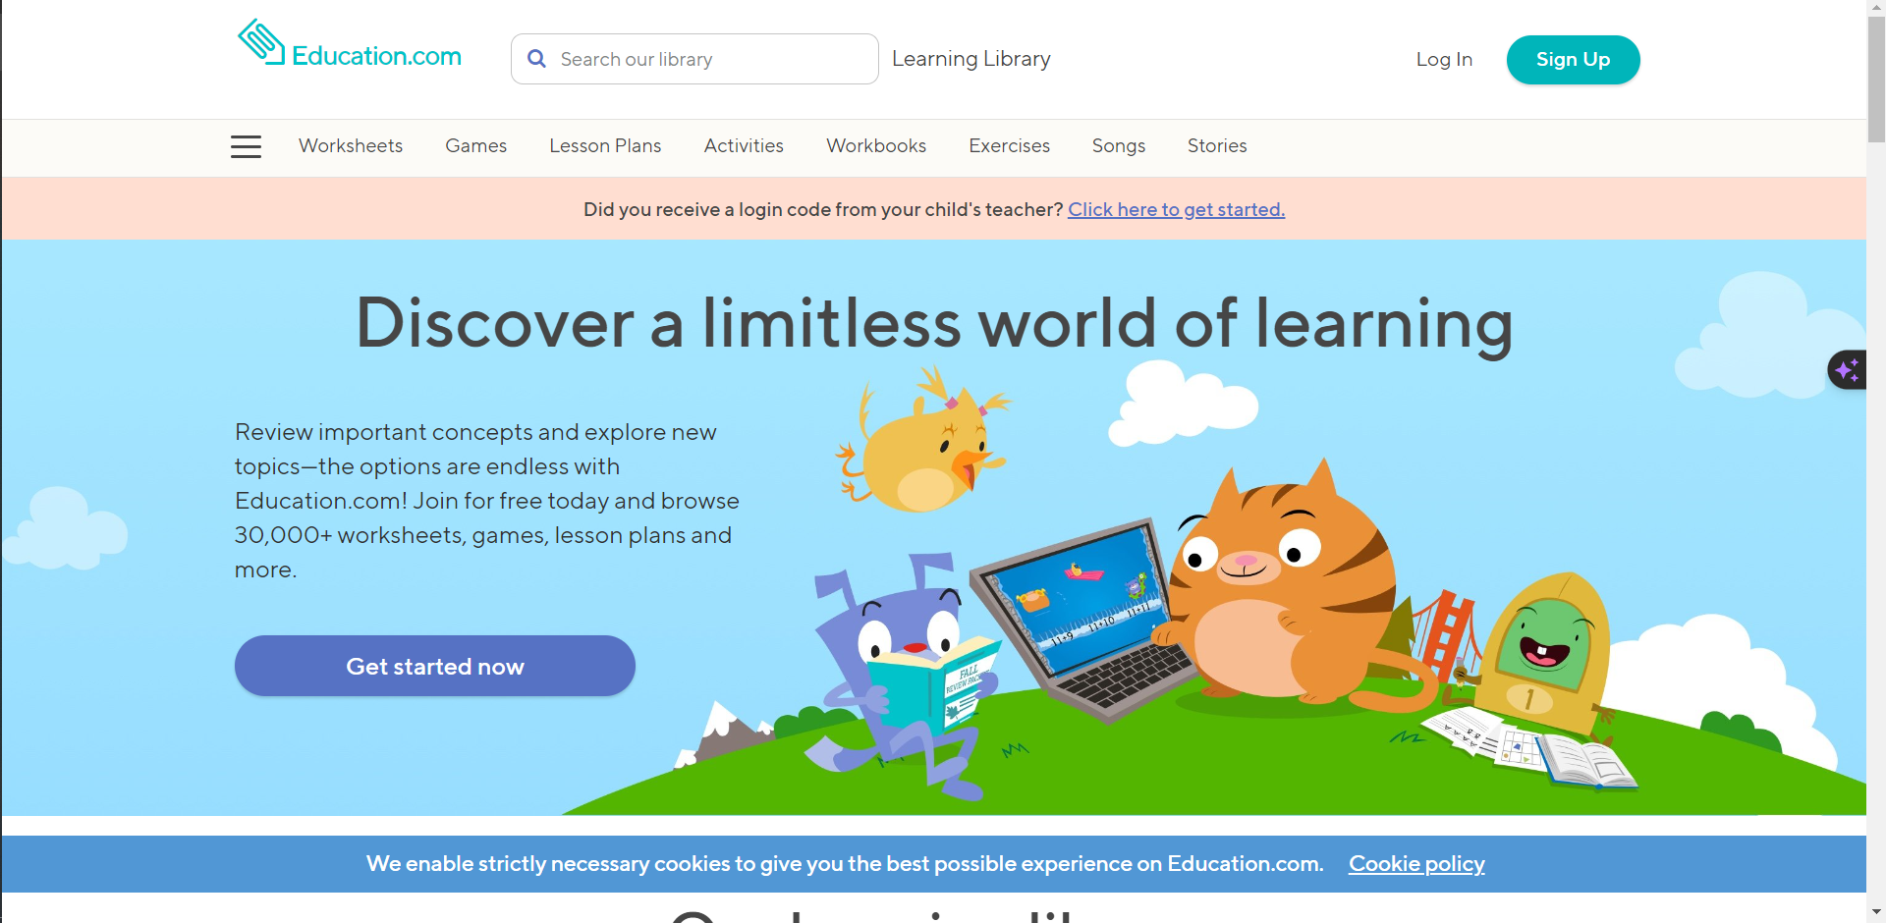
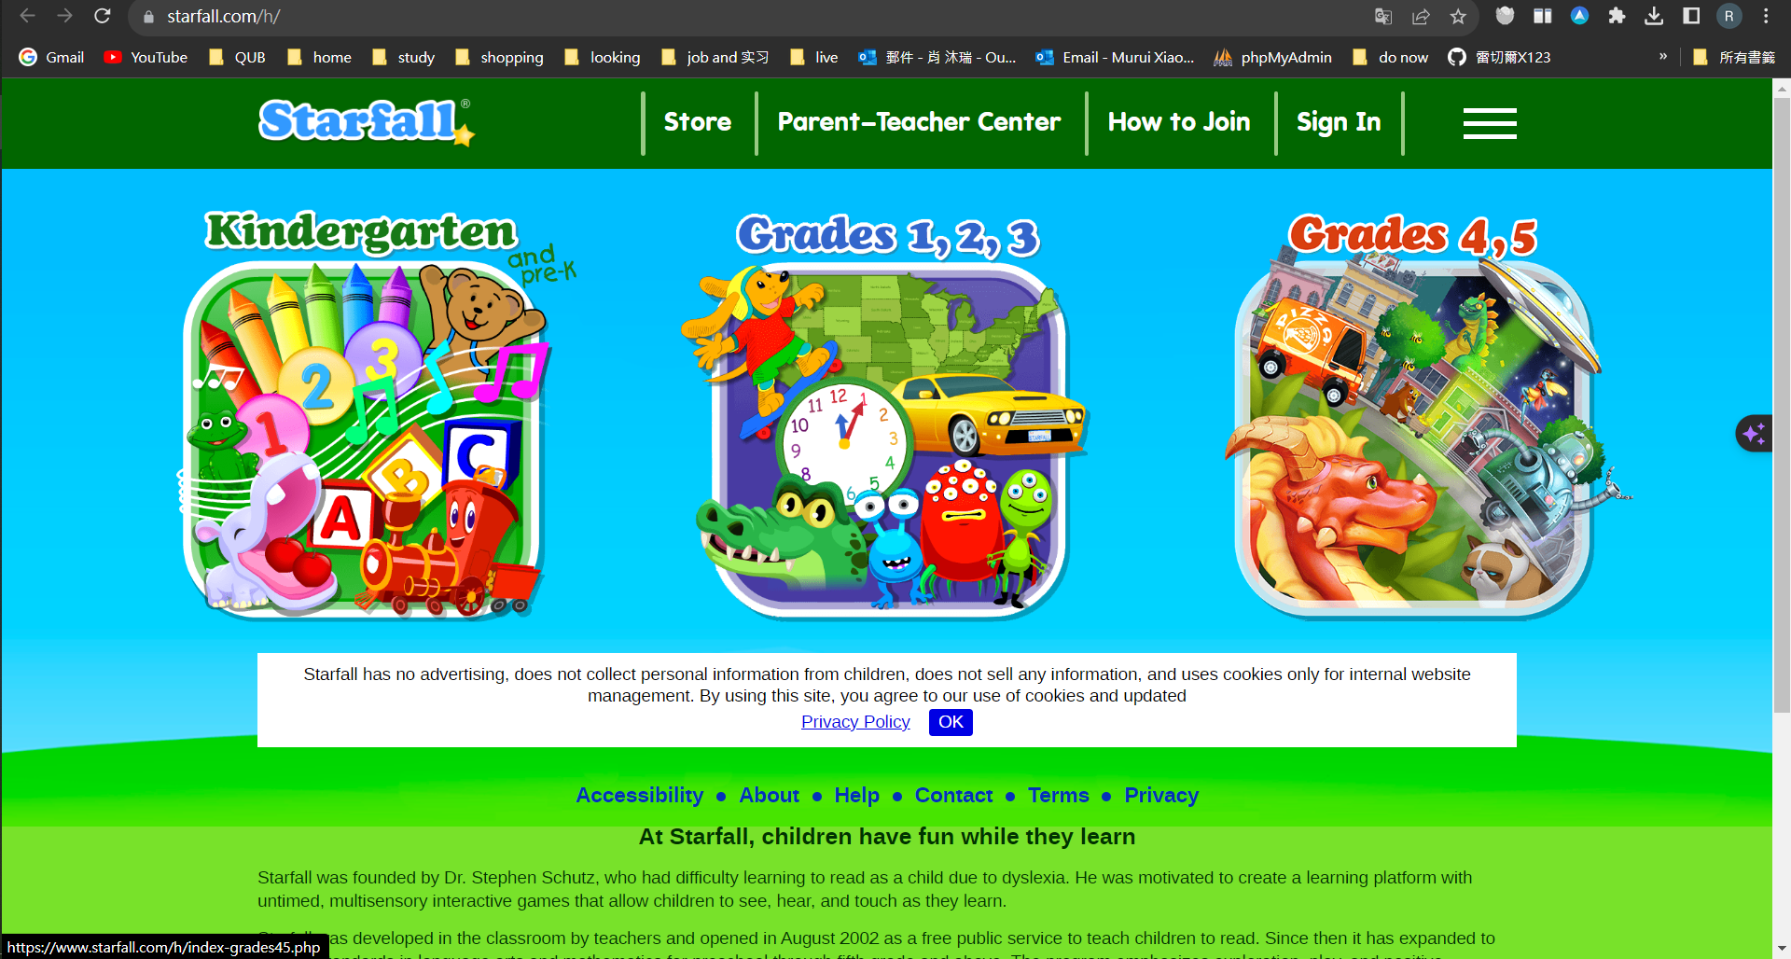
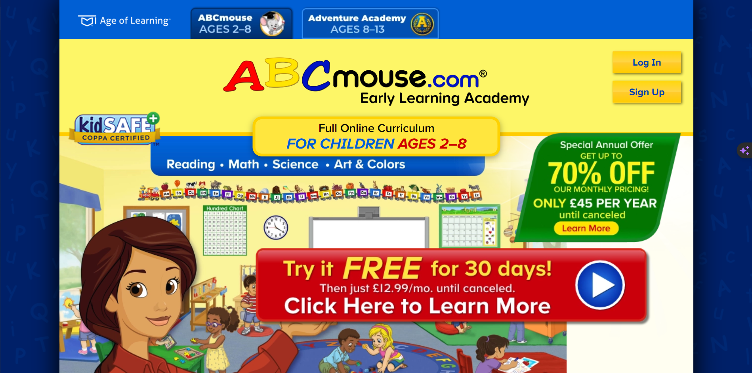
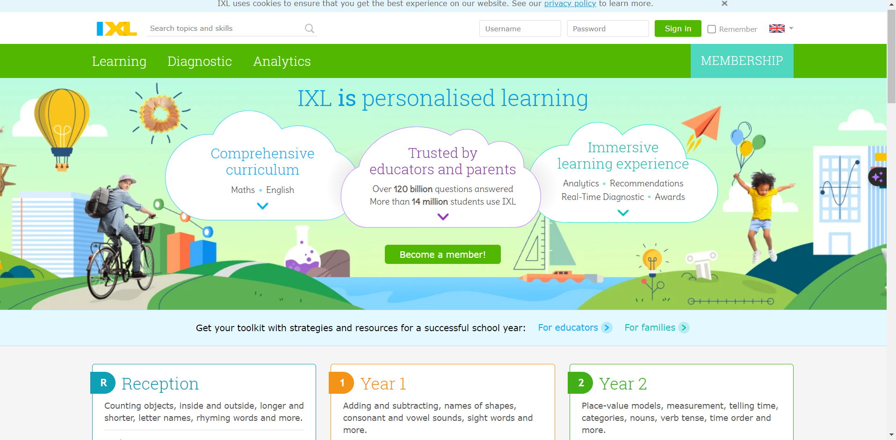
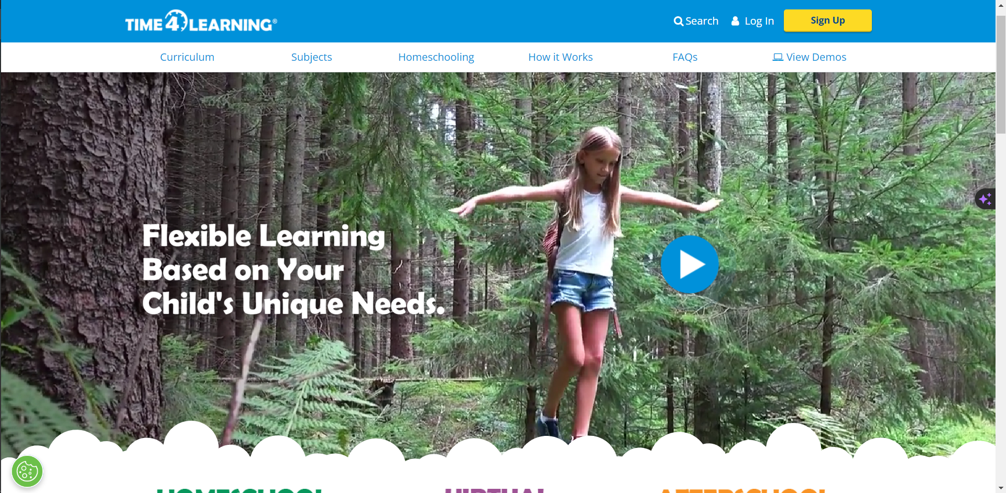
Finding some examples of website:
https://www.starfall.com/h/
https://www.education.com/
https://uk.ixl.com/?partner=google&campaign=81146728&adGroup=129630719167&gclid=Cj0KCQjwhL6pBhDjARIsAGx8D58R7GprI9ZBOjU7z0mQNbsy_78O9rxijpaOF02LlskUBQpa38qqFWgaAhzuEALw_wcB#curriculum
https://www.abcmouse.com/abc/?8a08850bc2=T2406874968.1697658620.4564
https://www.time4learning.com/

Slide 4
Asking question to User:
Have you used an application like this before?
Is it helpful to you after using it?
Is it easy to achieve the purpose?
What confuses you?
Is there anything that makes you feel uncomfortable?
What do you think could be improved?
Are you happy with the process?
Is the App easy to use？

Slide 5
Considering when developing
Different size of the screen
Different language
Function for disabled people
Colour: need to let them feel confutable
Easy to use
Protection against database attacks

Slide 6
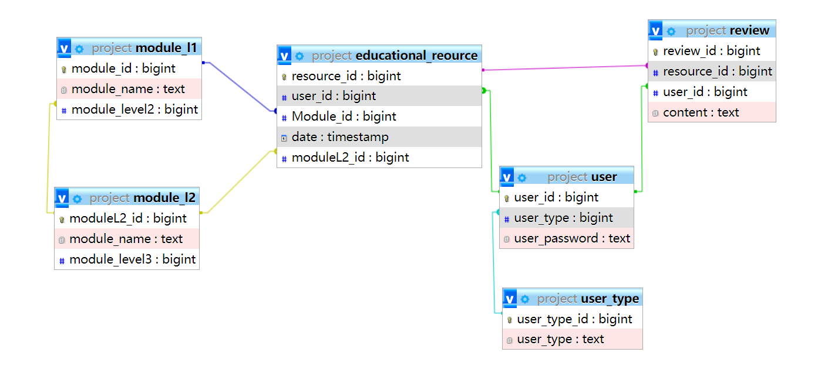
Database design:

